Slide 1
KNN Notes

Slide 2
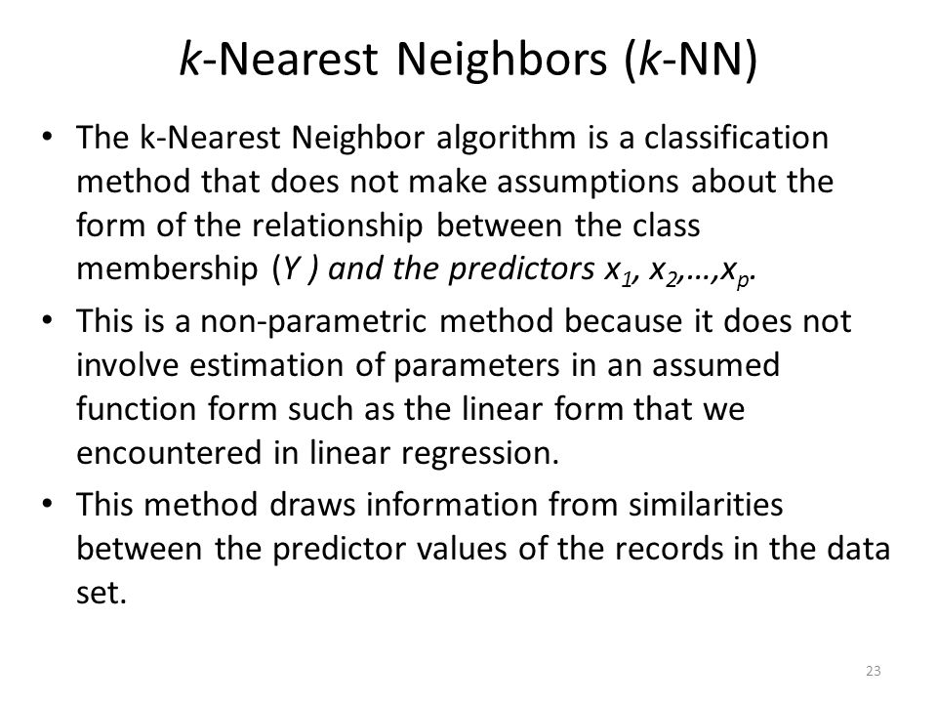

Slide 3
Summary
KNN is conceptually simple, yet able to solve complex problems
Can work with relatively little information
Learning is simple (no learning at all!)
Memory and CPU cost
Feature selection problem
Sensitive to representation

Slide 4
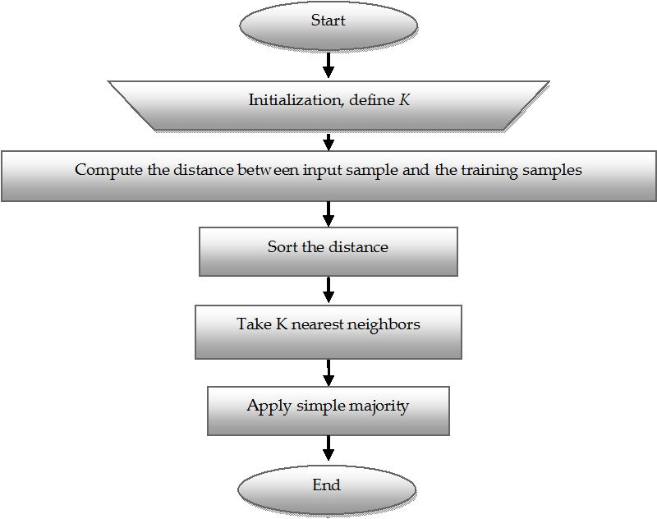

Slide 5
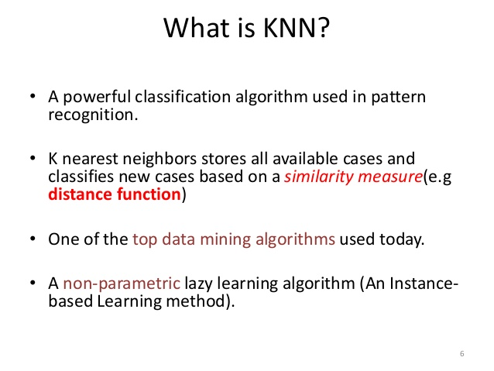

Slide 6
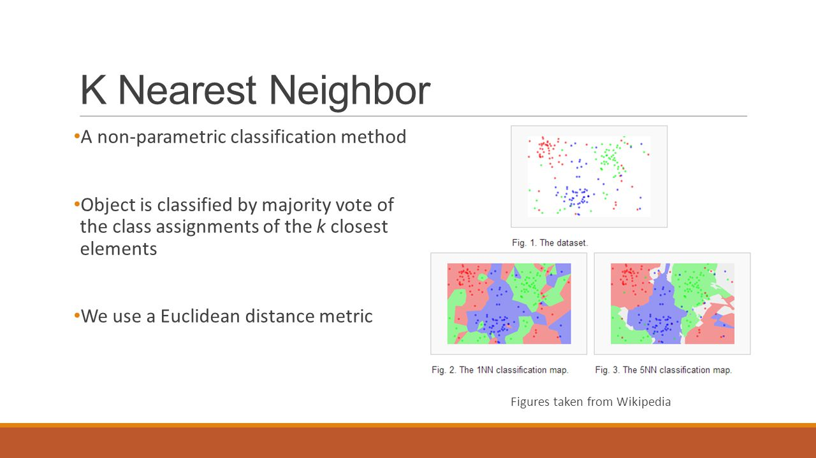

Slide 7
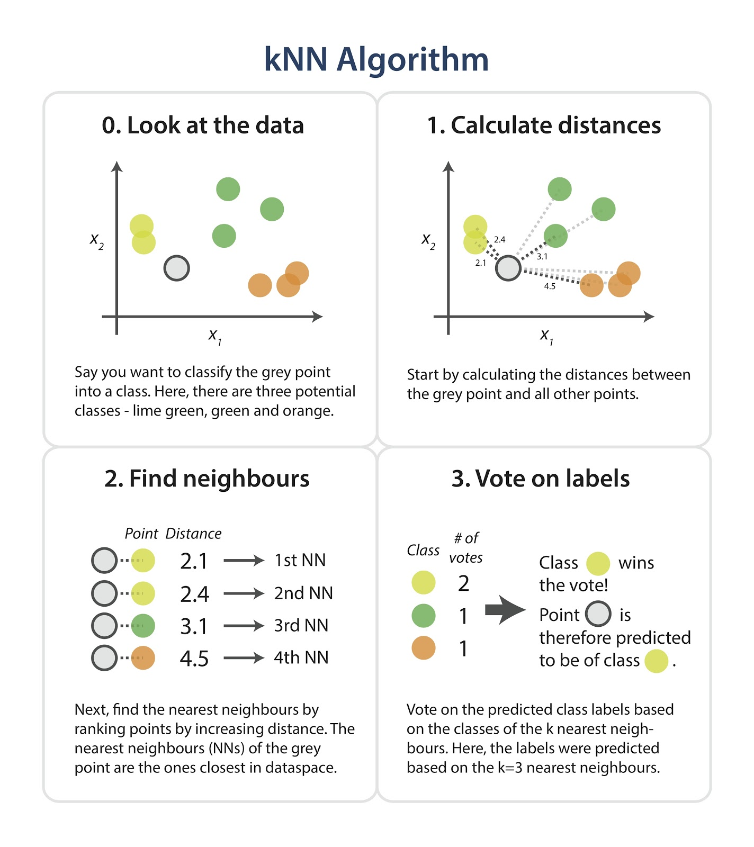

Slide 8
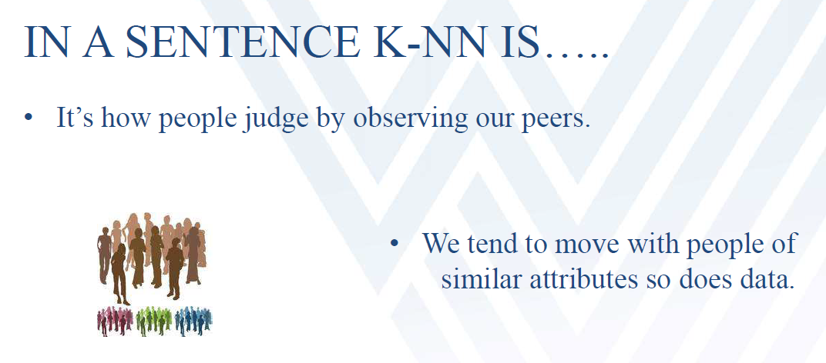

Slide 9
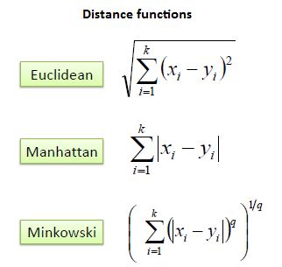

Slide 10
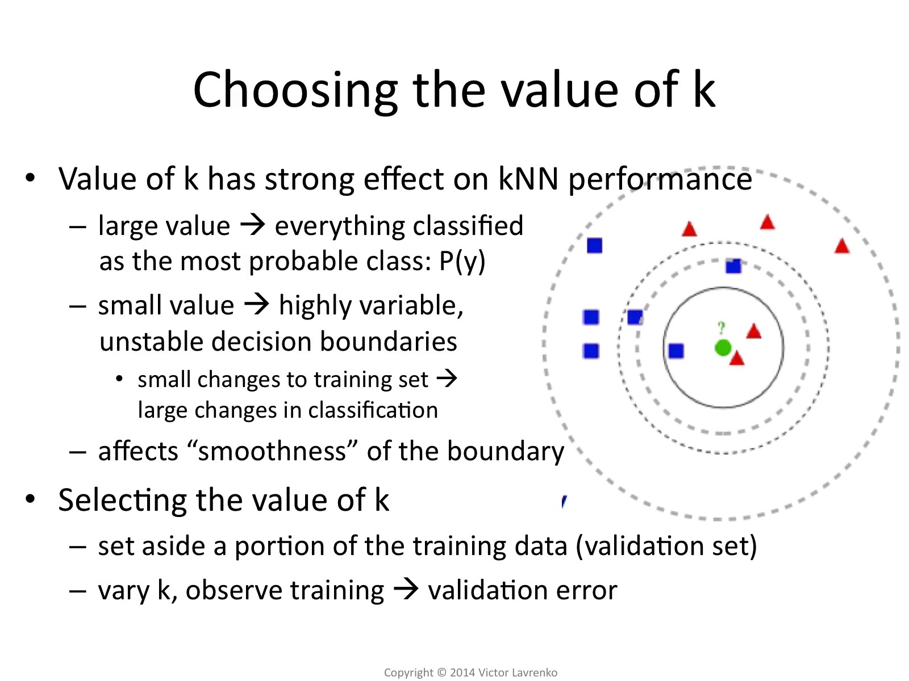

Slide 11
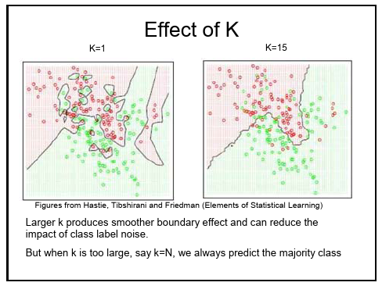

Slide 12
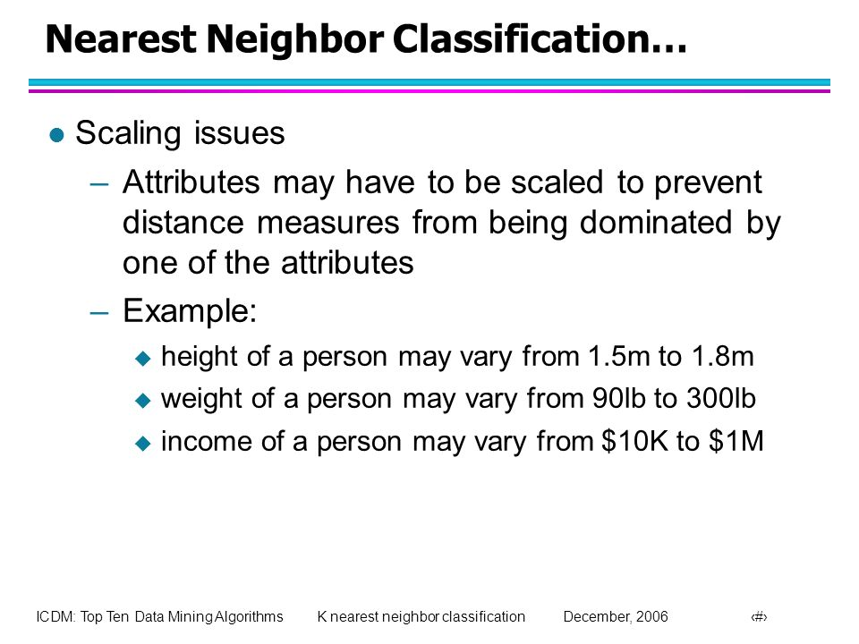

Slide 13
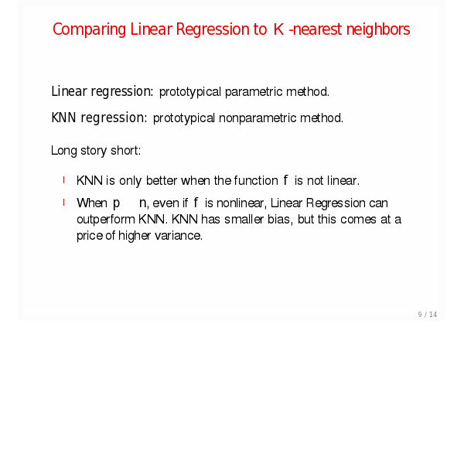

Slide 14
Advantages
Can be applied to the data from any distribution for example, data does not have to be separable with a linear boundary
Very simple and intuitive
Good classification if the number of samples is large enough

Slide 15
Disadvantages
Dependent on K Value
Test stage is computationally expensive
No training stage, all the work is done during the test stage
This is actually the opposite of what we want. Usually we can afford training step to take a long time, but we want fast test step
Need large number of samples for accuracy

